Slide 1
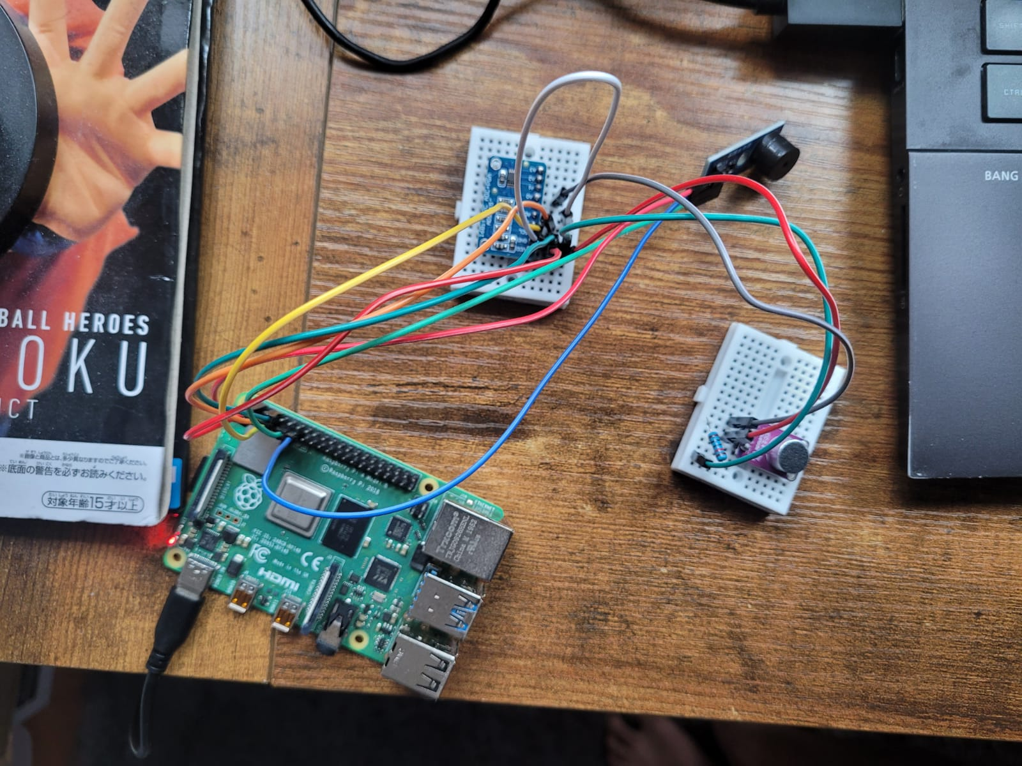

Passive Buzzer
ADS1115
$10kΩ$ Resistor
MAX4466 Microphone
Rpi-4B

Slide 2
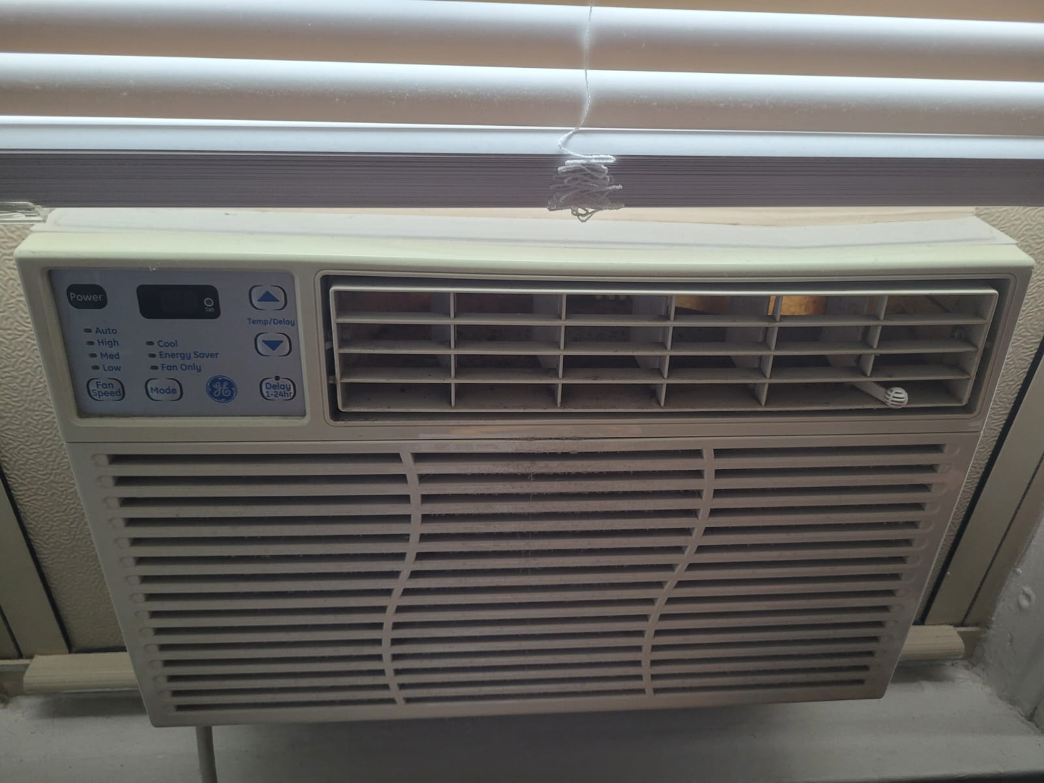
AC Fan – External Noise

